Slide 1
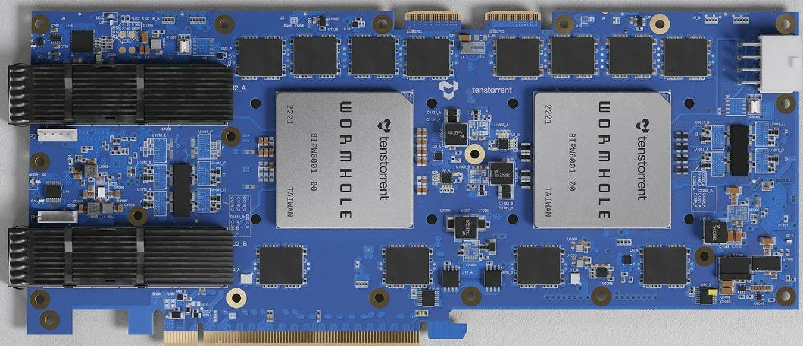


An overview of the Tenstorrent architecture

Slide 2
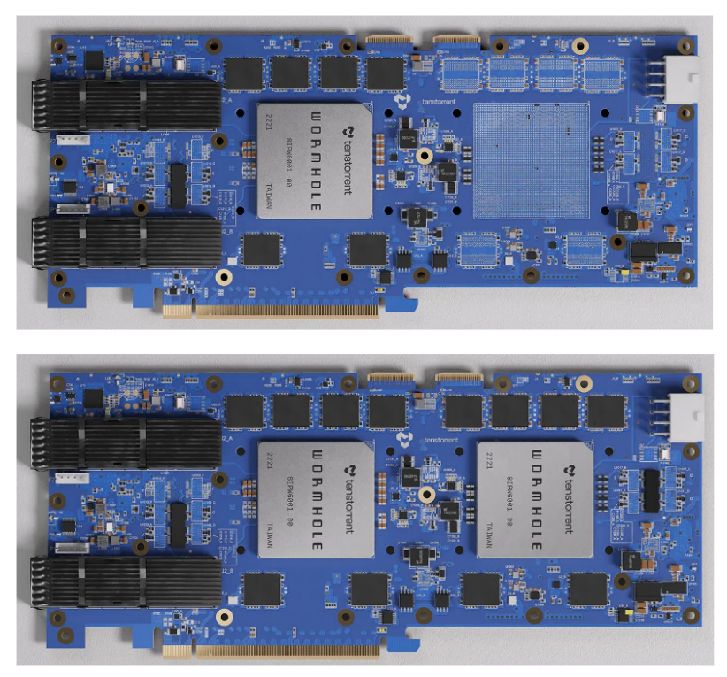
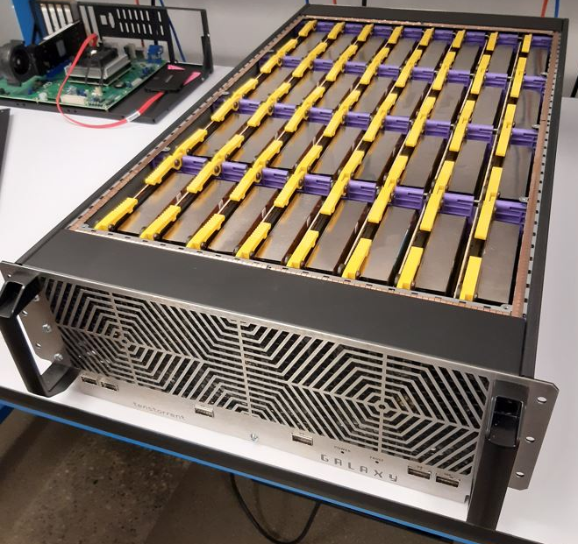
Scaling out rather than up
The Tenstorrent approach is to scale out a (fairly) simple initial compute unit across a chip and multiple chips
This simple unit is known as a Tensix unit (more on this soon….)
PCIe accelerator cards contain one or more chips, each with many Tensix units
Cards then scale by being interconnected together
These then all appear as a very large (virtual) chip
Can do this yourself with the correct cables and connectors
The Galaxy contains 32 Wormholes

Slide 3
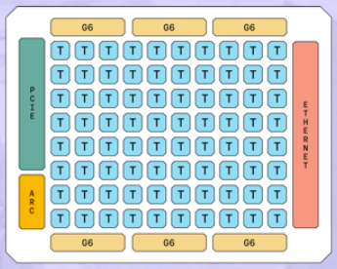
A single Wormhole chip….
Runs at 1GHz, built on a 12 nm process
Up to 24GB GDDR6 on the board
Draws up to 300 Watts
Performance:
466 TFLOPS (FP8)
131 TFLOPS (FP16)
262 TFLOPS (BLOCKFP8)
Tensix unit (up to 80 on a single chip)
16x100 Gbps Ethernet
16 lanes of PCIe Gen 4
Chip management
Six channels of GDDR6

Slide 4
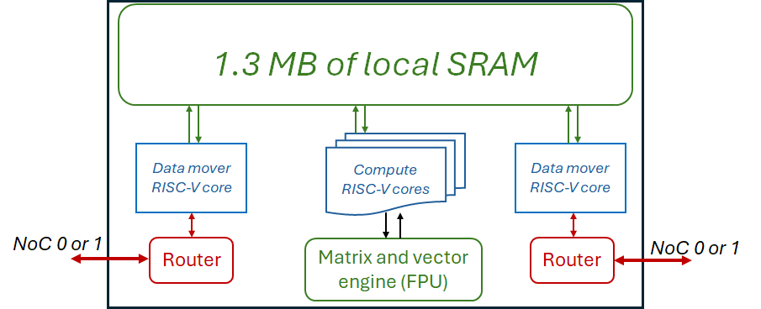
A Tensix unit
Each Tensix unit contains:
Five “baby” RISC-V CPU cores
Two of these are for data movement, three drive the compute side by driving the matrix and vector engine
A matrix and vector engine (FPU)
1.3MB of local fast SRAM (a bit like a cache)
Two routers (one connected to each data mover core)

Slide 5
Scaling out
Tensix unit (up to 80 on a single chip)
16x100 Gbps Ethernet
The Wormhole n300 we are using in the tutorial today has two of these chips on the board
Each has 64 Tensix cores and each is connected to 12GB of DDR6 (so 24GB DDR6 in total)
Two QSFP-DD 200G links that enable networking of cards
16 lanes of PCIe Gen 4
Chip management
Six channels of GDDR6

Slide 6
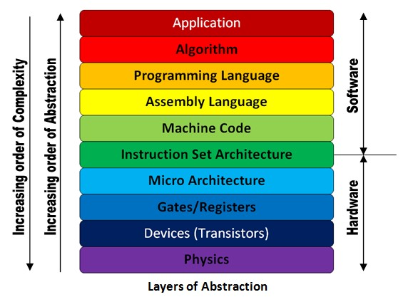
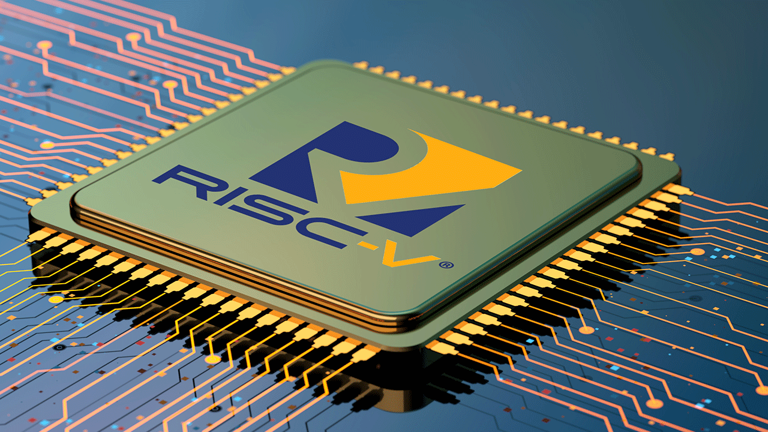
What is RISC-V anyway?
Started out by Berkley in 2012
An open Instruction Set Architecture (ISA) which is overseen by RISC-V International
Standardisation activities driven by expert members
Numerous areas of focus ranging from HPC & ML to the data centre to embedded computing
RISC-V is an Open Standard Instruction Set Architecture (ISA)
Software uses the ISA to tell the hardware what to do.
At the base level, the RISC-V ISA and extensions ratified by RISC-V International are royalty free and open base building blocks for anyone to build their own solutions and services on

Slide 7
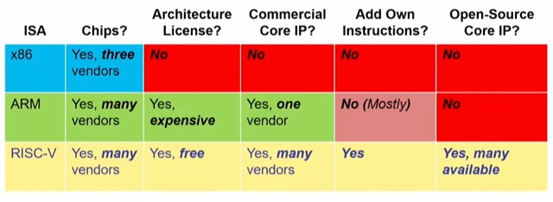
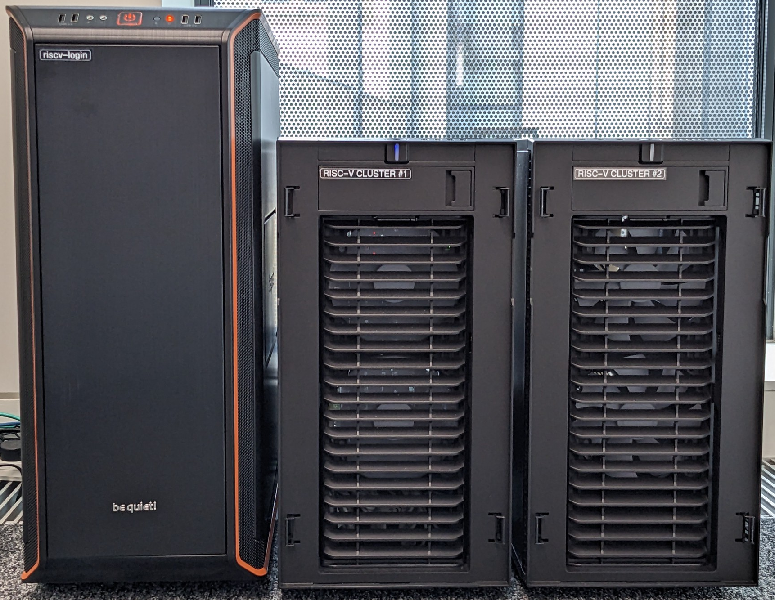
Why for HPC?
Modularity and freedom to design bespoke hardware such as the Tensix is the key advantage
Especially as we see an increased focus on energy efficiency
We will be running on the EPCC RISC-V testbed throughout this tutorial
Provides free access to RISC-V so people can experiment with their workloads for HPC
Is one of three officially sanctioned RISC-V labs by the standards body
Contains Tenstorrent Wormhole accelerators

Slide 8
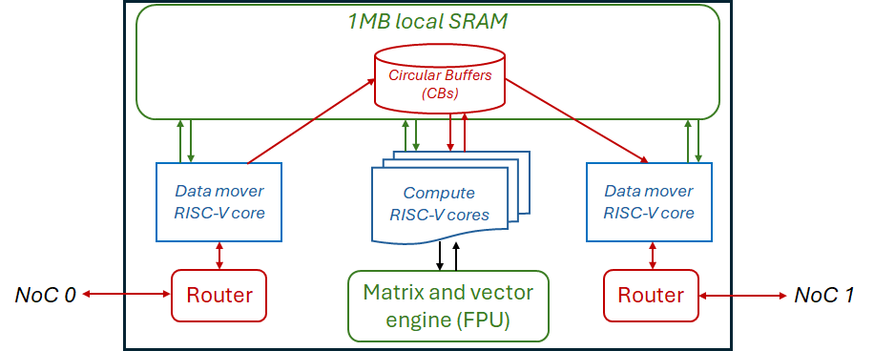
RISC-V CPU cores
The five “baby” CPU cores are very simple (32-bit RISC-V with Integer support)
Two data movers one to get data from external DDR (or another Tensix unit) in, and one to write results to DDR or another Tensix
Three compute cores that interact with the FPU
One packs data into registers of the FPU, one controls the FPU compute, and the third unpacks from FPU result registers to SRAM.
RISC-V cores communicate with each other via Circular Buffers (CBs)
CBs contain pages of memory, each is a configurable size and follows a producer-consumer approach.
Producers will wait until there is a free page, fill this and push to make it available
Consumers will block for a page to pushed and made available, read the data and then pop it

Slide 9
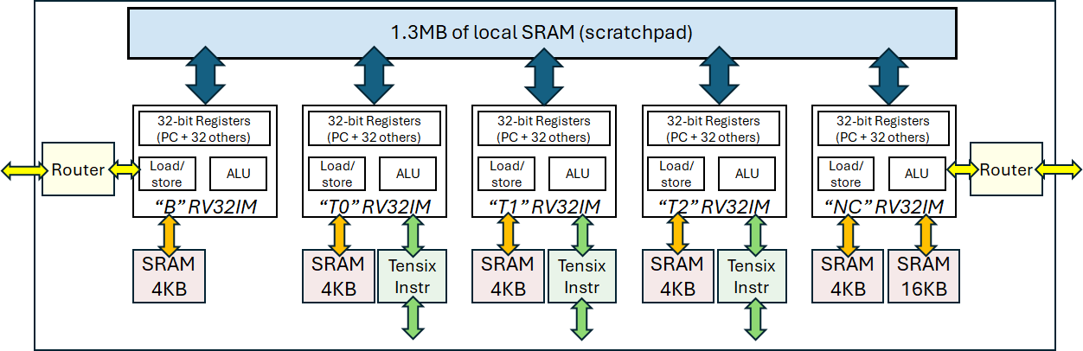
The RISC-V cores in more detail….
Each core has some associated SRAM as a local memory for data (and instructions for NC)
More details on the Tensix instructions and the compute later on….

Slide 10

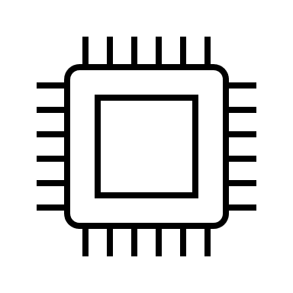
Programmer’s perspective
Host
PCIe accelerator
Input data to DDR
CB configuration
Kernels
Wormhole
Results from DDR

Slide 11
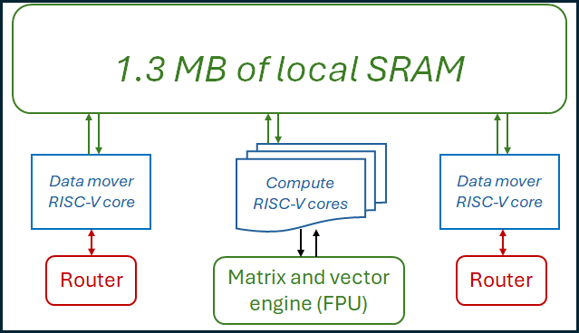
Programmer’s perspective
Host code is written by the programmer
Three kernels are written by the programmer:
Data movement in core
Compute cores
Data movement out core
Kernel
Kernel
Kernel
As we will discuss later, these can be replicated across Tensix units or individual kernels allocated on a unit by unit basis
In the host code, each kernels path and name is provided
When the host code is launched then each kernel is first compiled and launched

Slide 12
TT-Metalium SDK
Models
PyTorch
ONYX
Models
Tools
TT-Forge
ML graph compiler
https://github.com/tenstorrent/tt-forge-fe
Manually optimised Models
TT-MLIR
Compiler support for Tensix
https://github.com/tenstorrent/tt-mlir
TT-NN
Optimised ML building block operations
https://github.com/tenstorrent/tt-metal
Our focus today
TT-Metalium
Direct programming SDK
https://github.com/tenstorrent/tt-metal
TT-LLK
(Low level kernels)
Low level interaction with hardware
https://github.com/tenstorrent/tt-llk

Slide 13
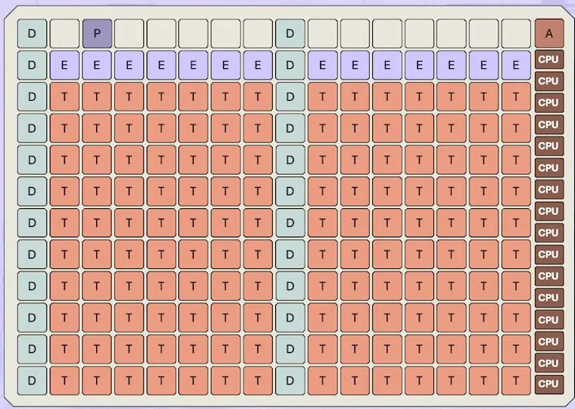
Blackhole: Beyond the Wormhole
The Blackhole is Tenstorrent’s next generation of accelerator
Shipping from their website, and we have a couple in the testbed system (although we are using the Wormhole today).
Enhanced Tensix cores are combined with 16 RISC-V application processors (CPU) that run Linux
Clocked at 1.35GHz, 32GB of DDR6, four QSFP-DD 800G network links
Performance:
774 TFLOPS (FP8)
194 TFLOPS (FP16)
387 TFLOPS (BLOCKFP8)

